Slide 1

SECD2523 DATABASE
SQL INSTALLATION
Week 3

Slide 2
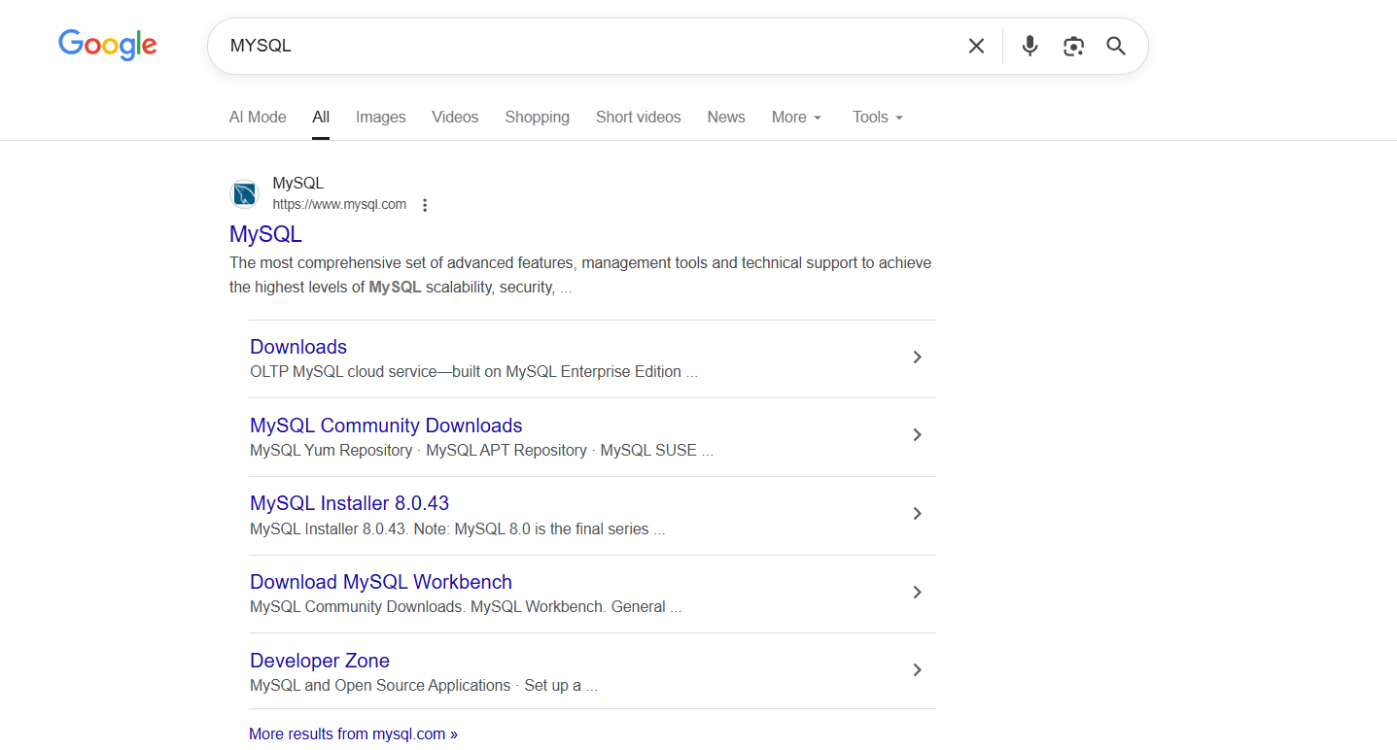
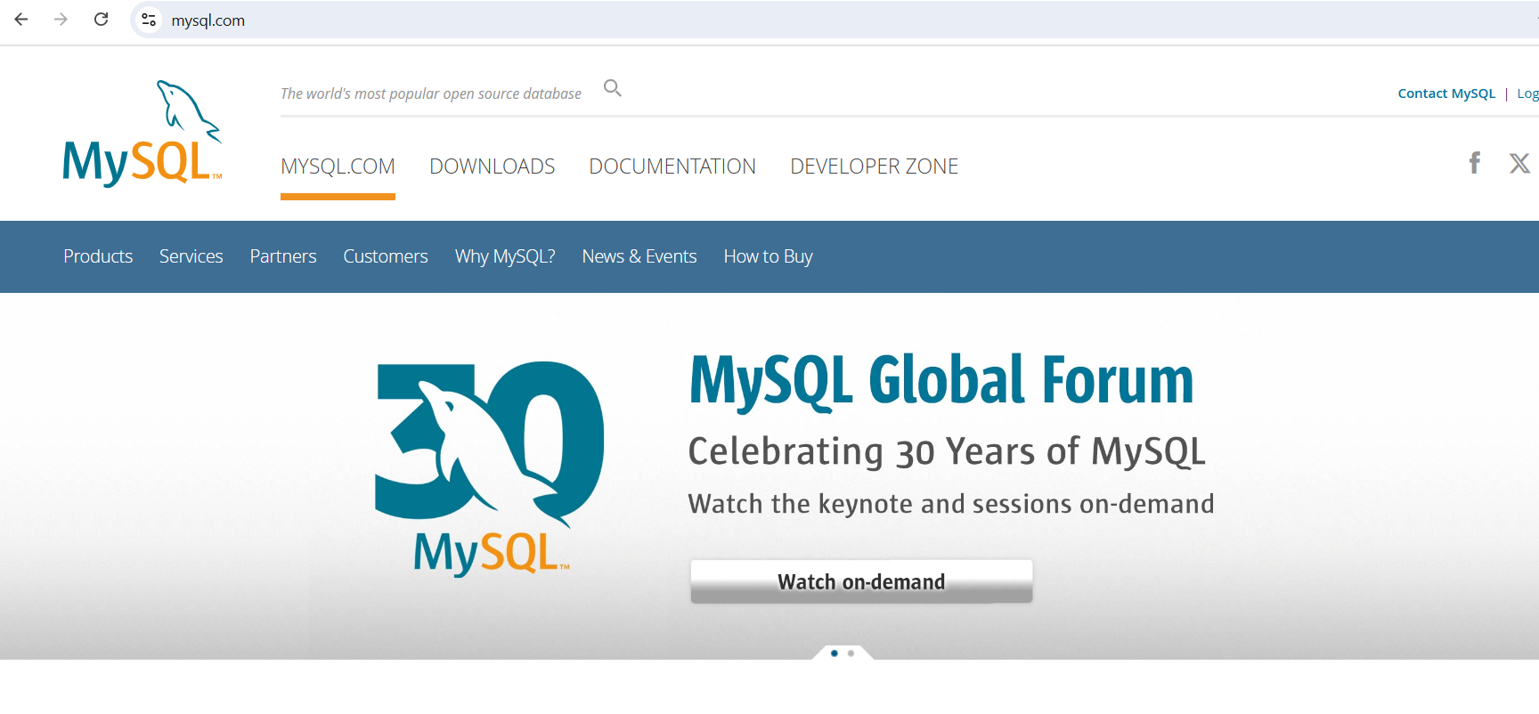
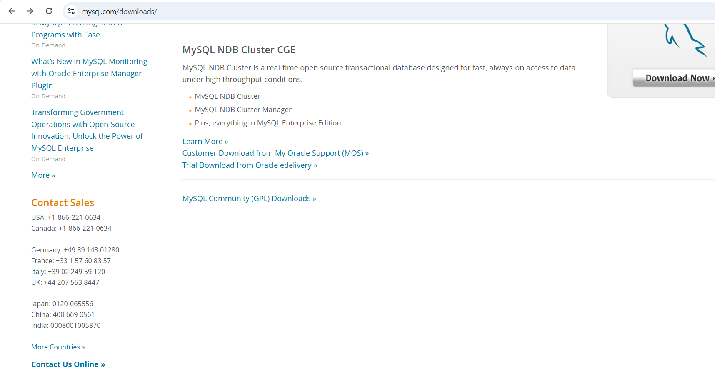
Step 1 Download MySQL Installer
Click Downloads & Scroll down
Go to mysql.com
Click this link or you may directly access this link :
https://dev.mysql.com/downloads/

Slide 3
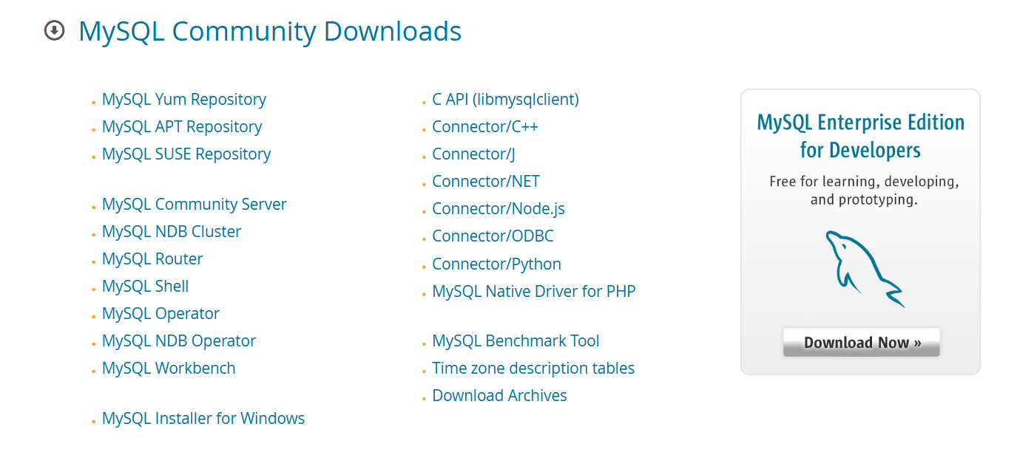
Step 1 Download MySQL Installer
For Mac users, click on this MySQL Community Server
For Windows users, click on this MySQL Installer for Windows

Slide 4

Installing MySQL on Windows

Slide 5
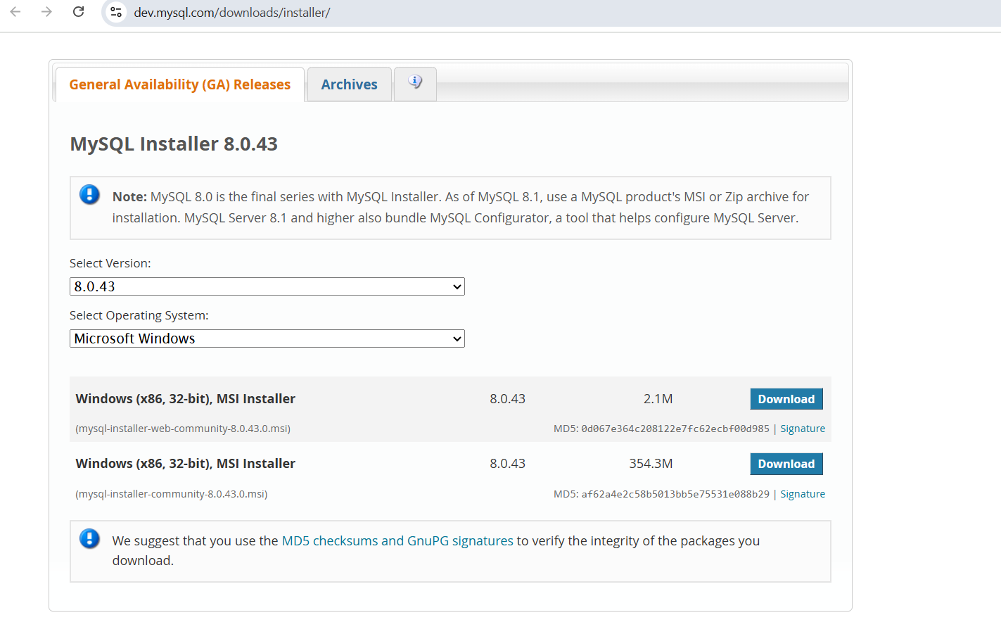
Step 1 Download MySQL Installer (Windows)
Choose Option 2 full installer, click Download

Slide 6
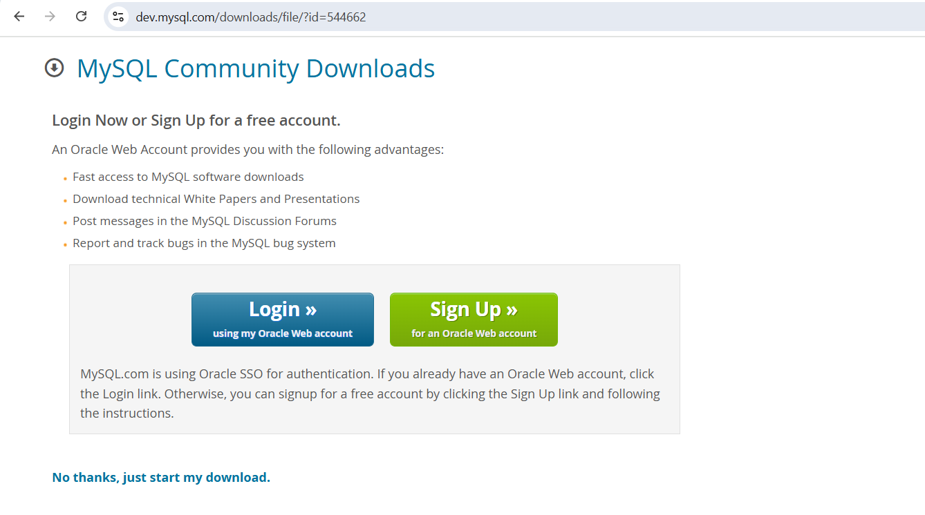
Step 1 Download MySQL Installer (Windows)
Click Download

Slide 7
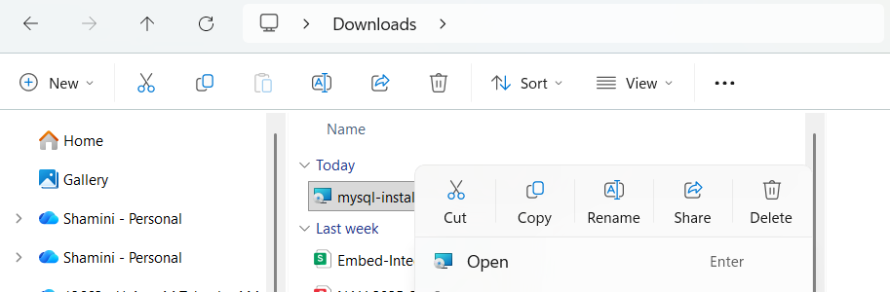
Step 1 Download MySQL Installer (Windows)
Right-click downloaded mysql installer and click Open

Slide 8
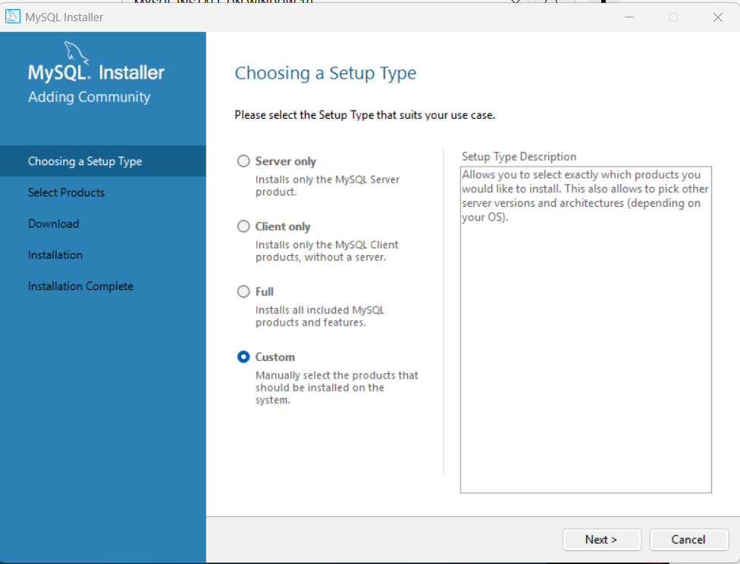
Step 2 Run the Installer (Windows)
1
Choose Custom
2
Click Next

Slide 9
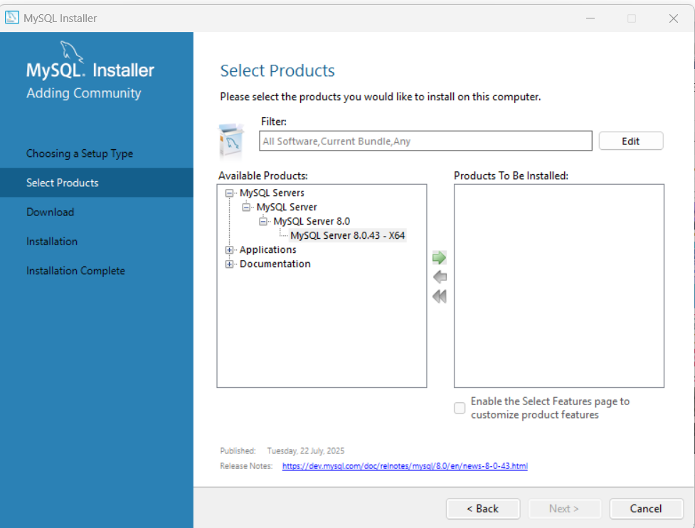
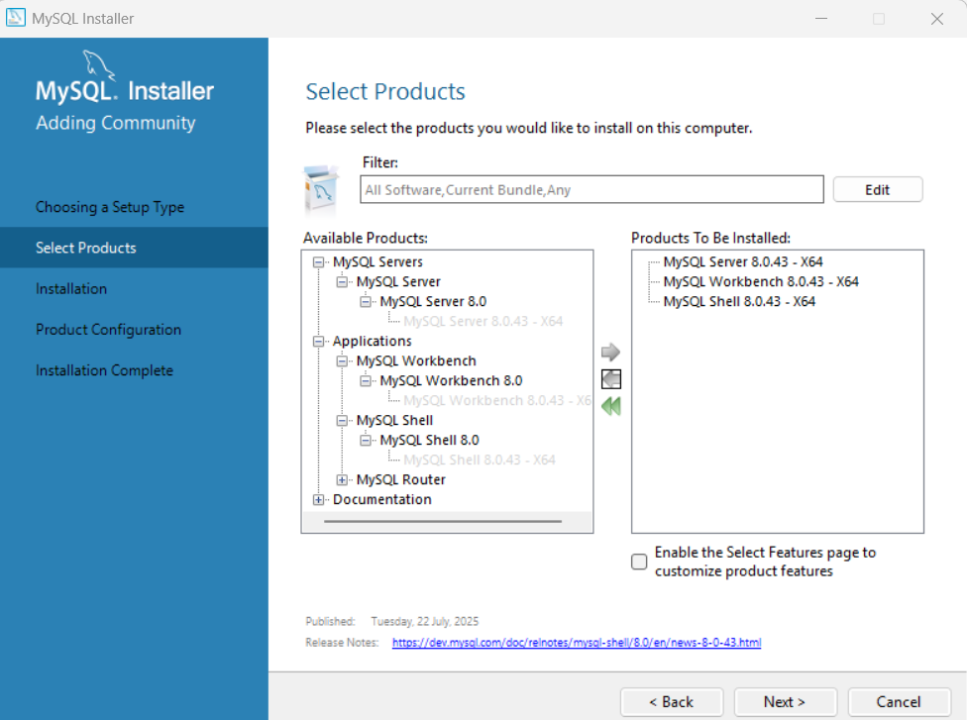
Step 2 Run the Installer (Windows)
2
1
4
3
5
Choose the available products to be installed and click the Green Arrow
Make sure to add:
MySQL Server
MySQL Workbench
MySQL Shell
Then Click Next

Slide 10
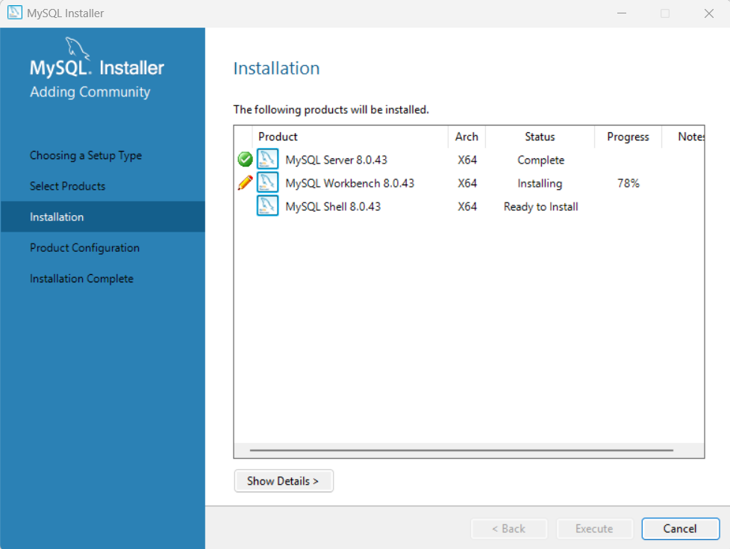
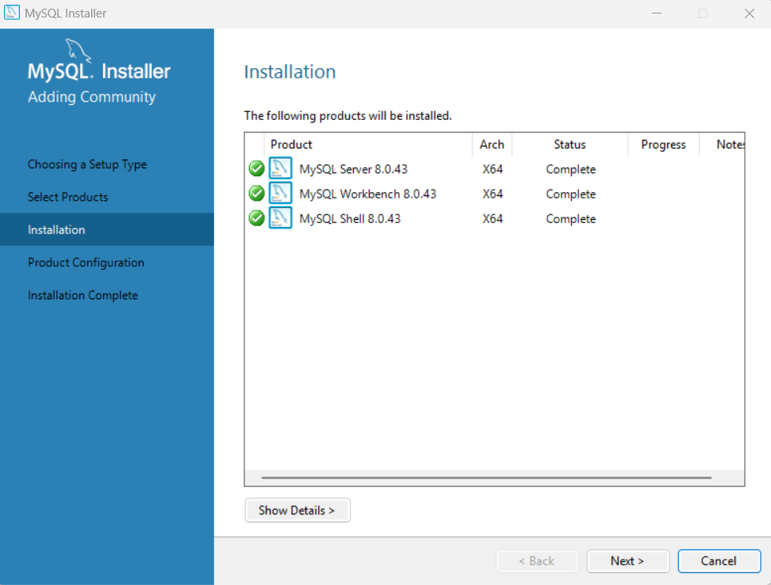
Step 2 Run the Installer (Windows)
1
2
Make sure click Execute
The installed products shall show the status COMPLETE and Proceed Next

Slide 11
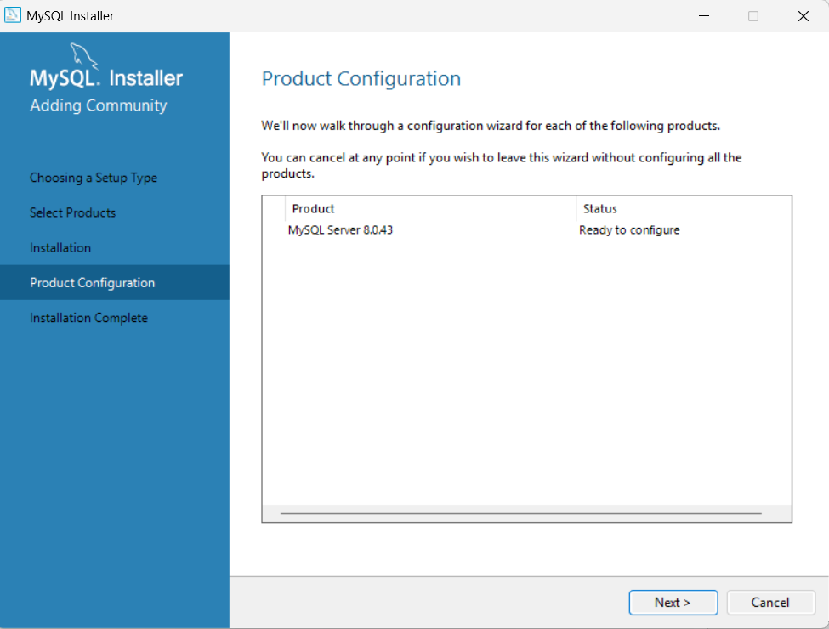
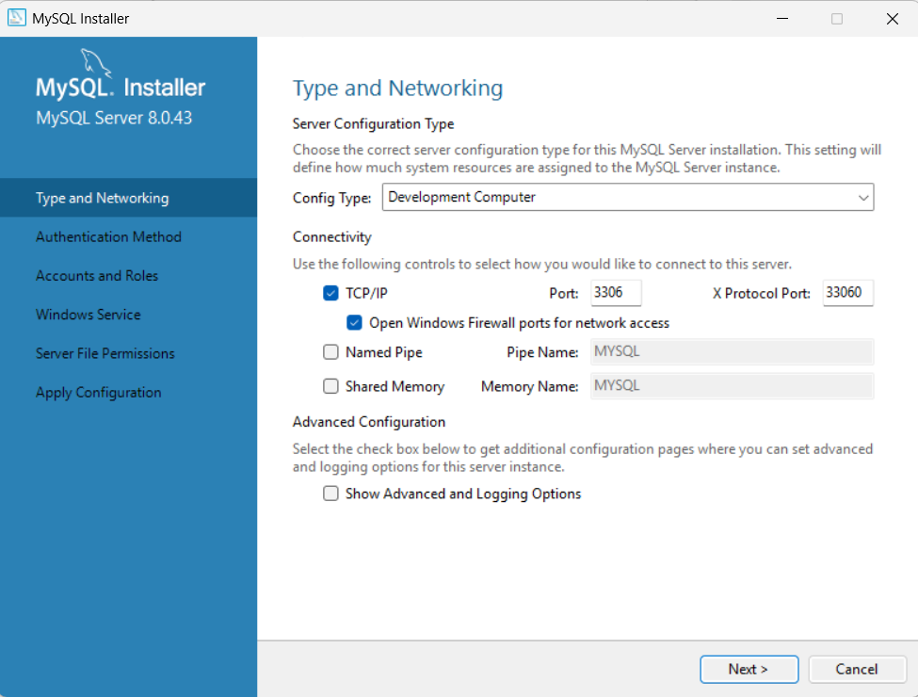
Step 3 Configure MySQL Server (Windows)
1
2
Maintain the Server Configuration as it is

Slide 12
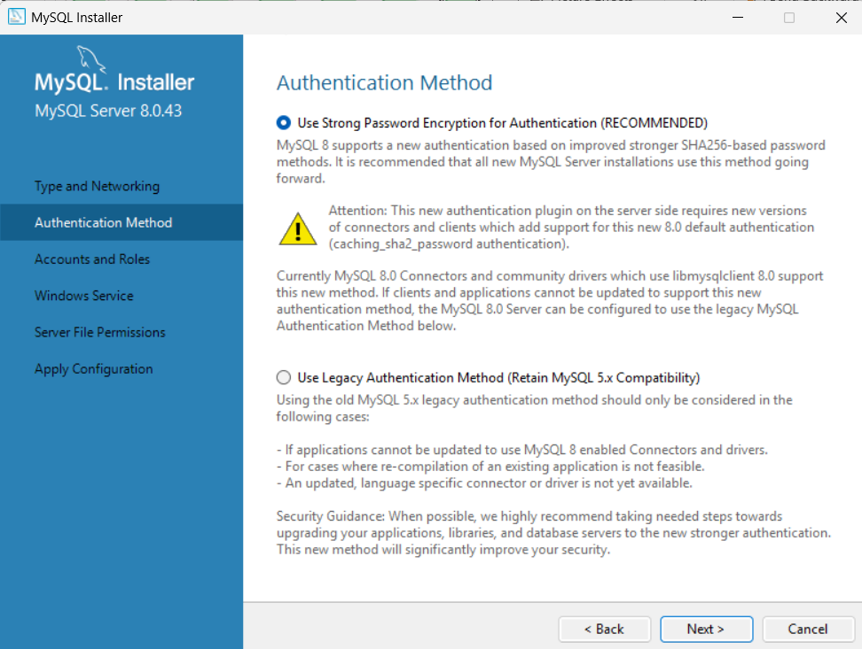
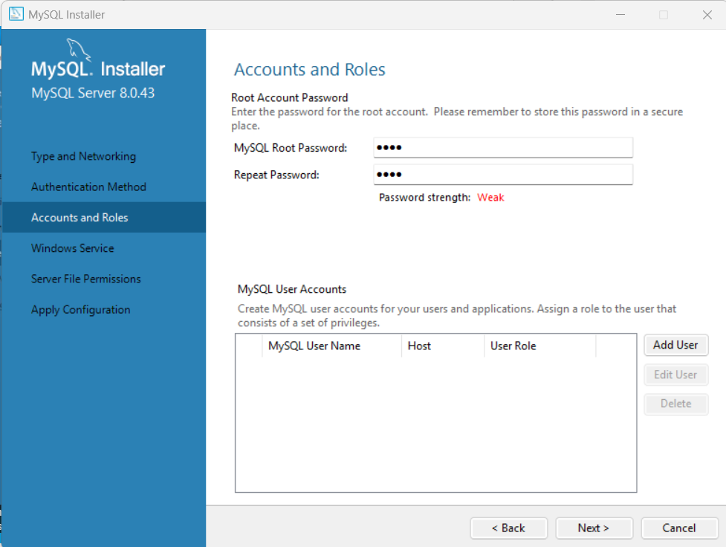
Step 3 Configure MySQL Server (Windows)
1
2
2
Click Next
Make sure you know your MySQL root password.
Example : admin123
IMPORTANT

Slide 13
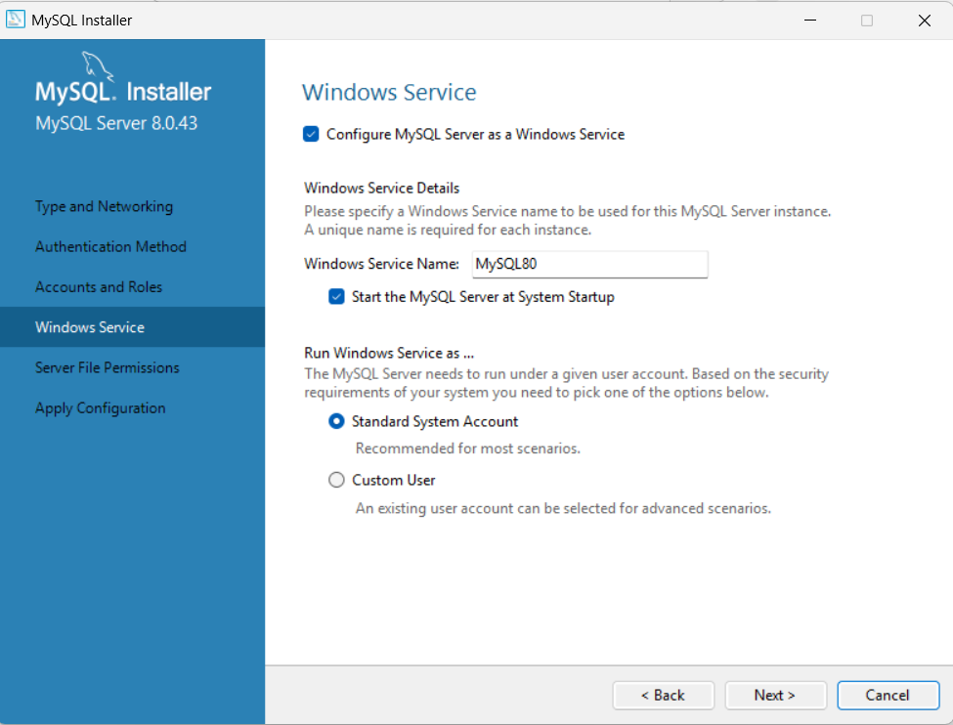
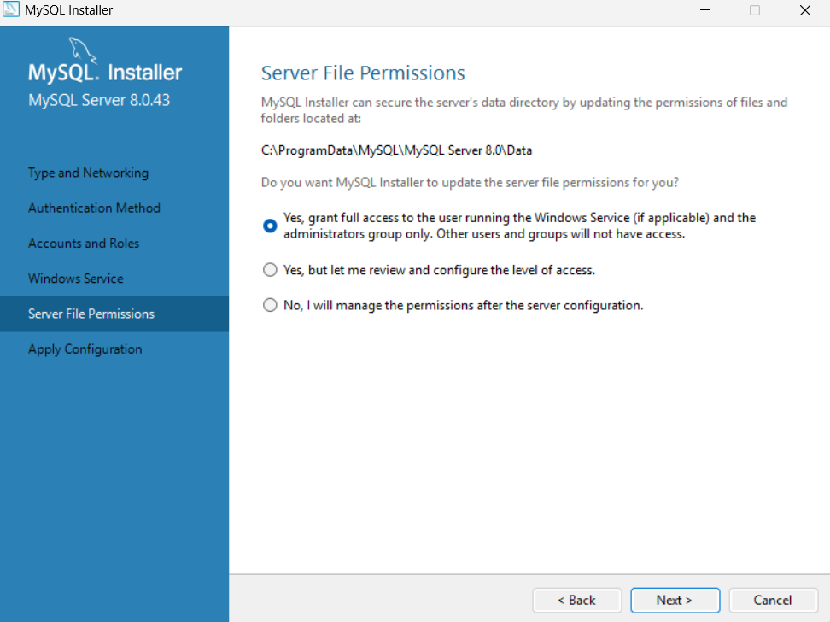
Step 3 Configure MySQL Server (Windows/Mac)
Select the first option
1
2
Make sure Windows Service as it is

Slide 14
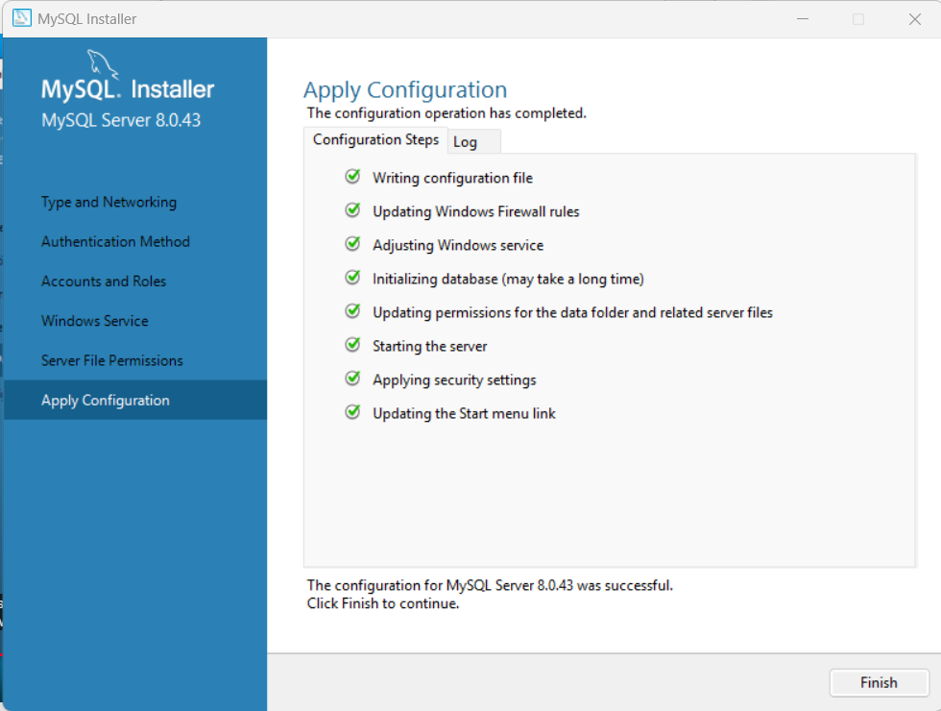

Step 3 Configure MySQL Server (Windows)
Click Execute and apply the configuration, make sure all configuration steps are complete.
1
Click Next
2

Slide 15
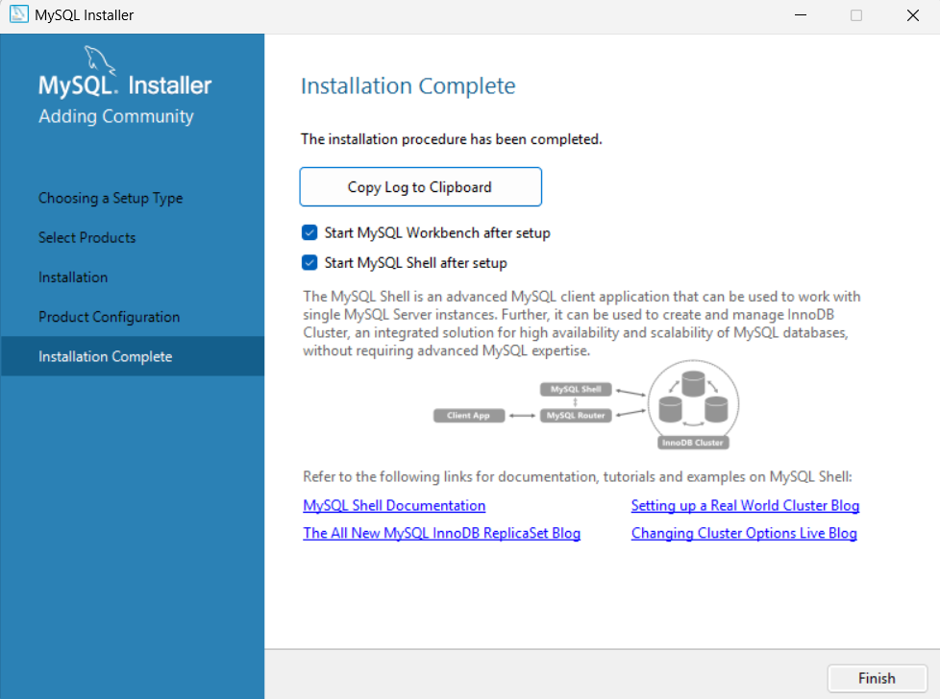
Step 4 Complete Installation (Windows)
1

Slide 16
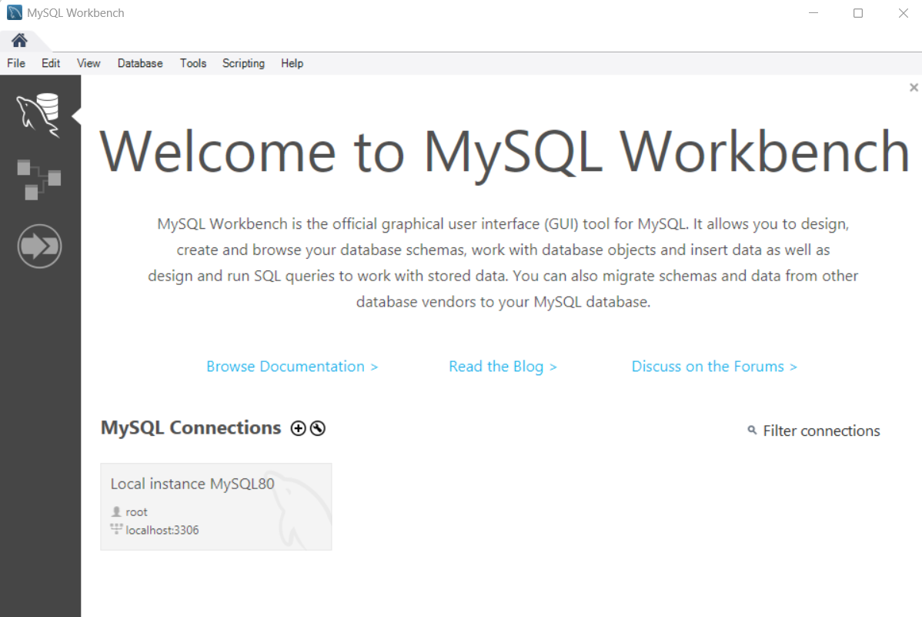
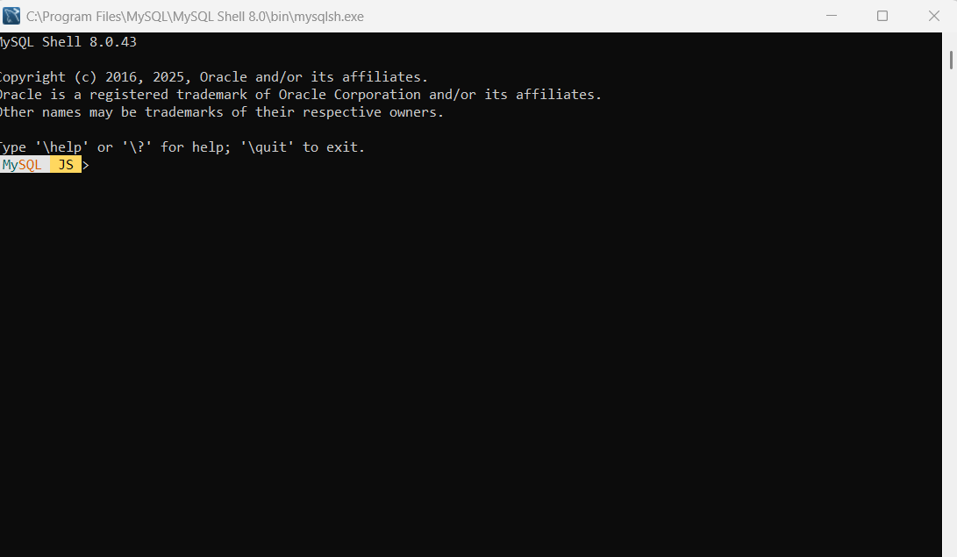
Step 4 Complete Installation (Windows)
You shall now able to access MySQL Workbench and MySQL Shell

Slide 17
Installing MySQL on Mac

Slide 18
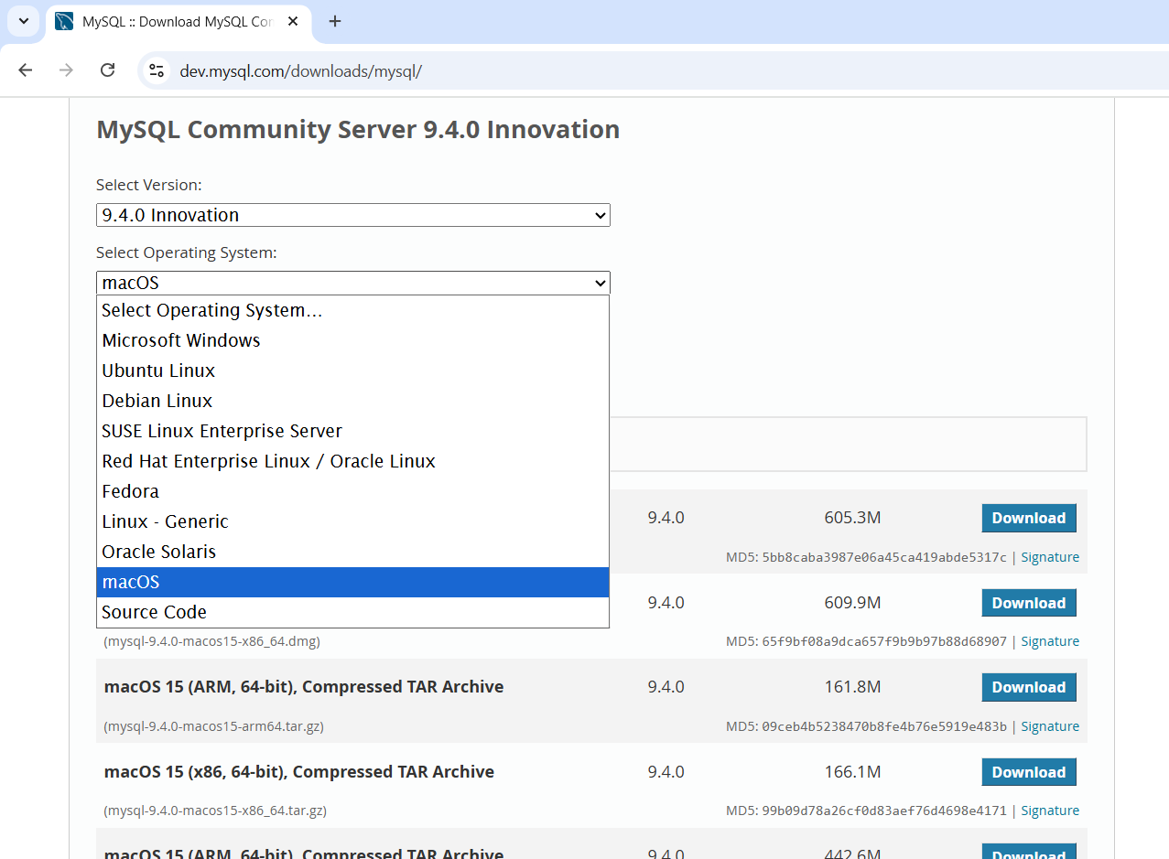
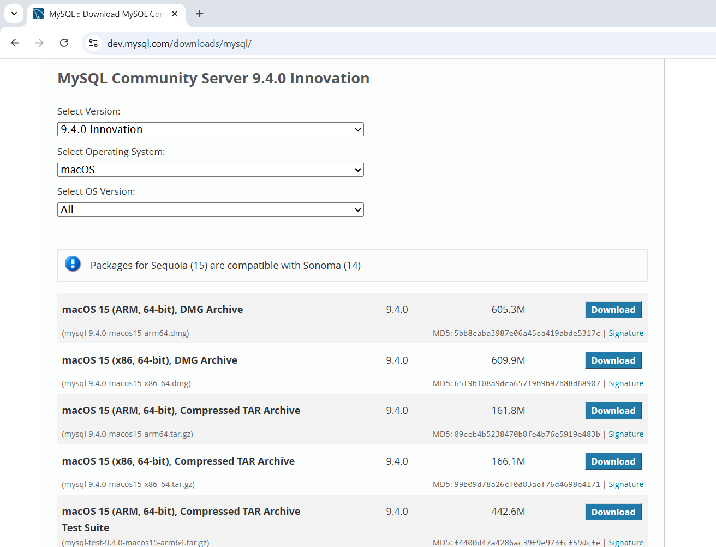
Step 1 Download MySQL Installer (Mac)
You may refer to the following guideline for installation:
https://zarkomaslaric.notion.site/Zarko-s-Video-Tutorial-MySQL-Installation-on-Mac-14cfe1ebfde2804c933fecff0e02ca51
And https://www.youtube.com/watch?v=wpGnJHb2R58&t=336s
Select the right OS suitable to your machine
1
2
Choose the right option, click Download. Suggested.

Slide 19
Step 1 Download MySQL Installer (Mac)
Click Download

Slide 20
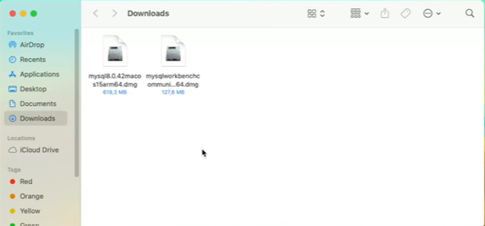
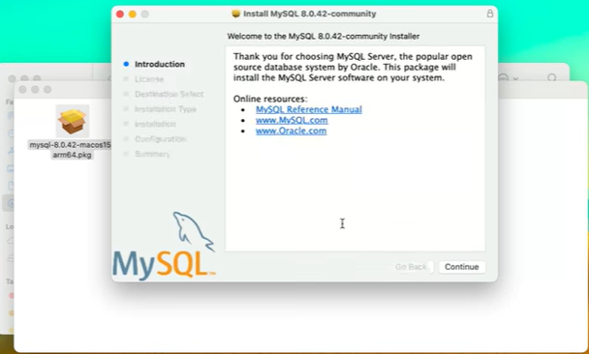
Step 1 Download MySQL Installer (Mac)
Start downloading MySQL installation (Begin with MySQL server DMG file).
Begin with installation of MySQL, click Continue.

Slide 21
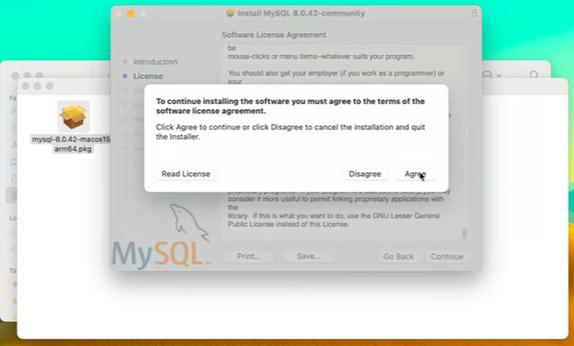
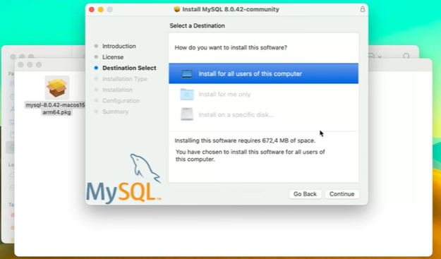
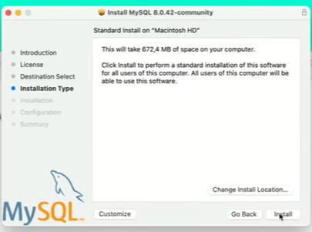
Step 1 Download MySQL Installer (Mac)
Proceed to Agree the software license agreement.
1
2
Choose to Install
You may choose the Default Destination and proceed to Continue
3

Slide 22
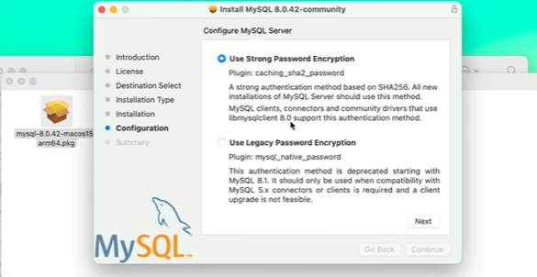
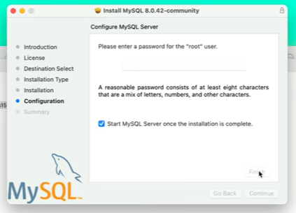
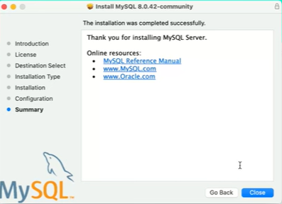
Step 1 Download MySQL Installer (Mac)
Choose use Strong Password Encryption.
Click Next
1
2
Make sure you know your MySQL root password.
Example : admin123
IMPORTANT
Finish installation.
3

Slide 23
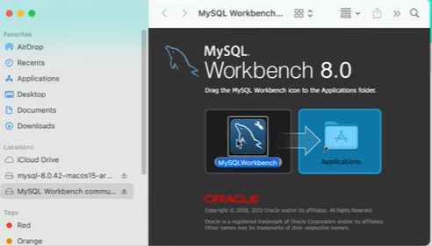
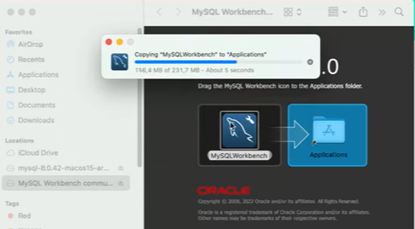
Step 2 Download MySQL Workbench (Mac)
Start downloading MySQL Workbench.
Drag and Drop MySQL Workbench to the Application Folder.

Slide 24
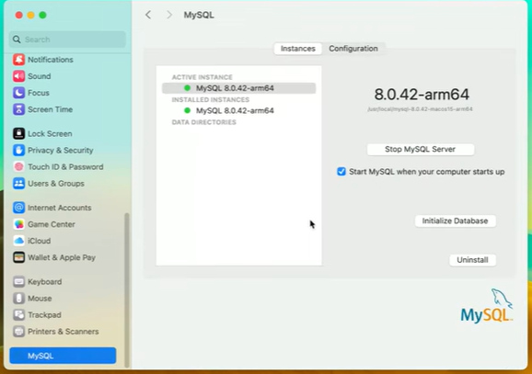
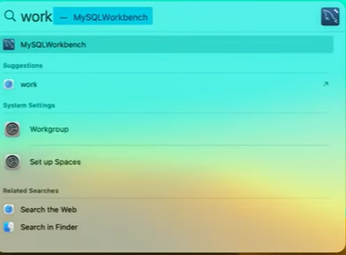
Step 3 Access MySQL (Mac)
MySQL Server Instance is running (In Settings).
You can start and stop server here
Select MySQLworkbench

Slide 25
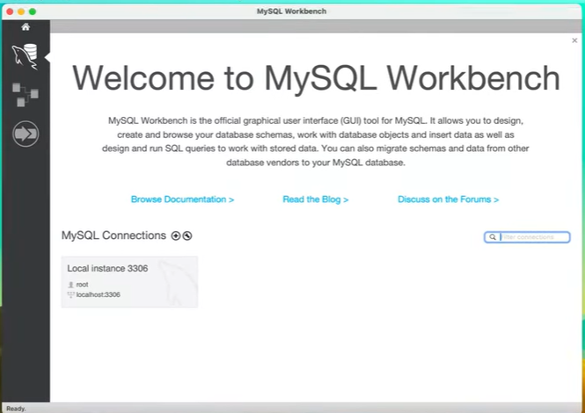
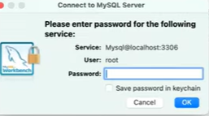
Step 3 Access MySQL Workbench (Mac)
Key in the password and access the workbench

Slide 26
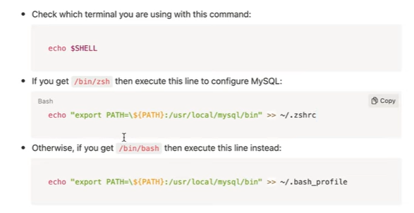
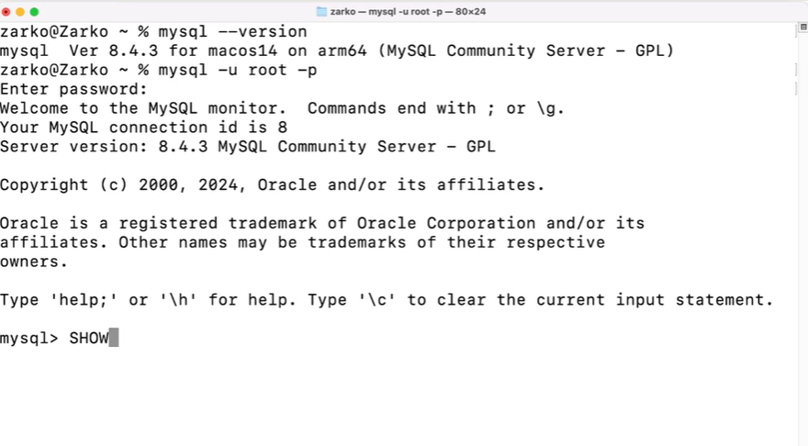
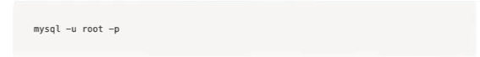
Step 4 MySQL Terminal Configuration (Mac)
1
This is based on the output you get
2
Command to start MySQL in the terminal:
3
4

Slide 27
Verification after Installation

Slide 28
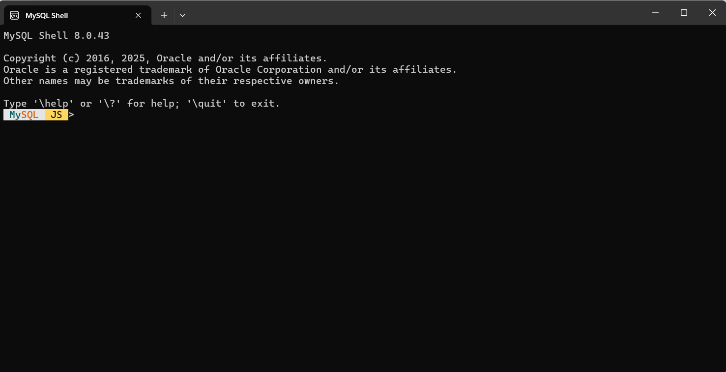
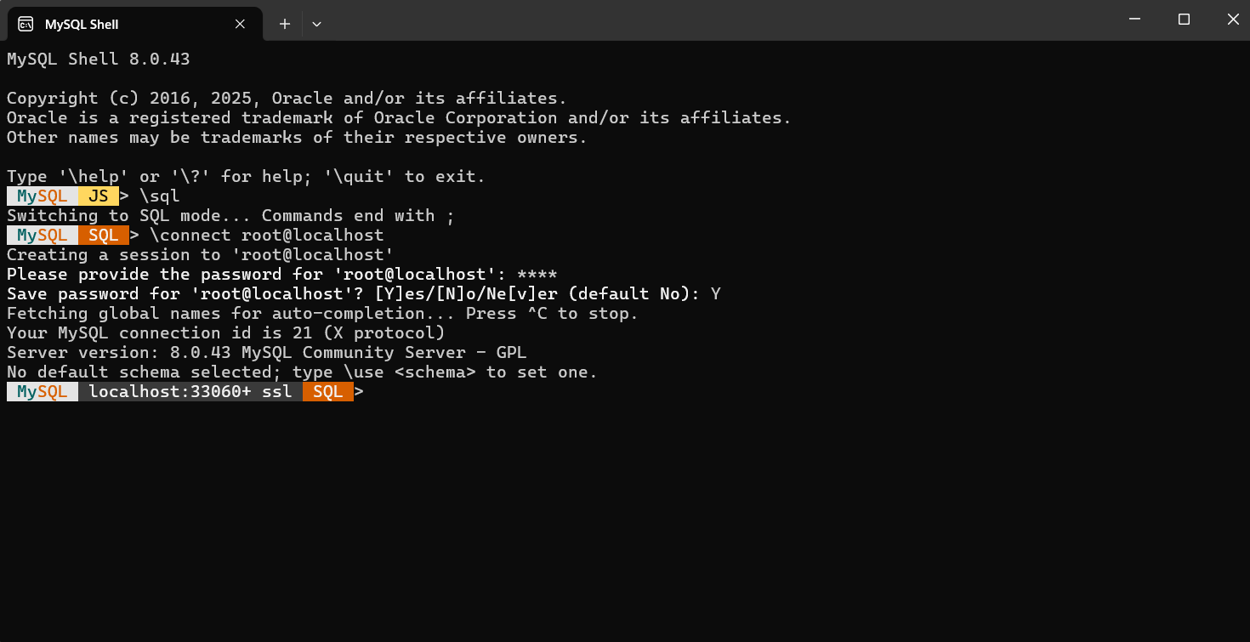
MySQL Shell (Windows)
After installation:
Test MySQL Shell
Your MySQL Shell is open and successfully switched to SQL mode, which means the installation was successful.
\sql
\connect root@localhost
Enter your password
Type Y to save password or N that indicated No save password.

Slide 29
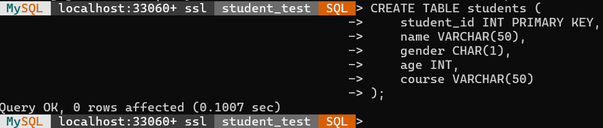
MYSql Shell (Mac/Windows)
Once connected, create your practice database:
Create database student_test;
Use student_test;
This is to create table. Next, insert the data into table.

Slide 30
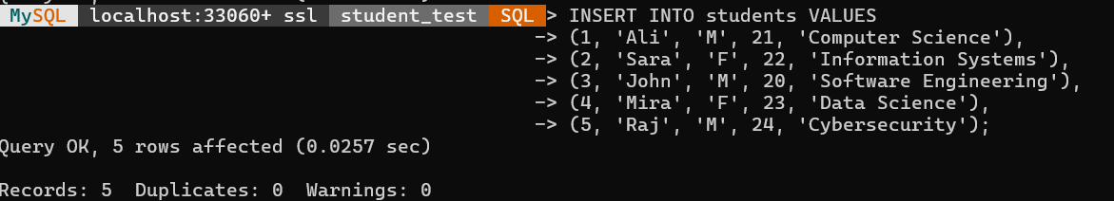
MYSql Shell (Mac/Windows)
Insert the following data in MYSQL shell.

Slide 31
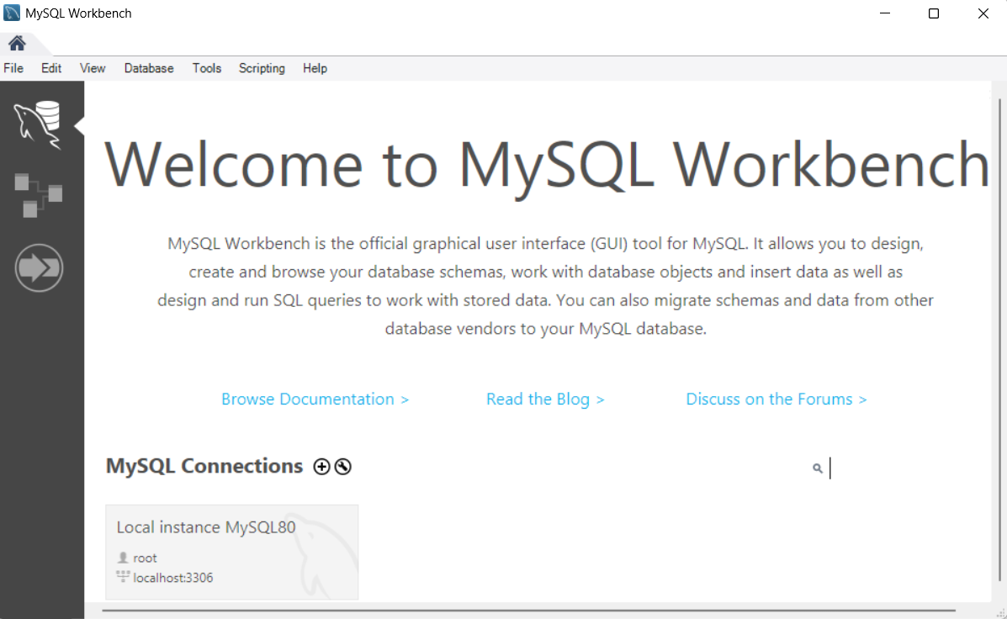
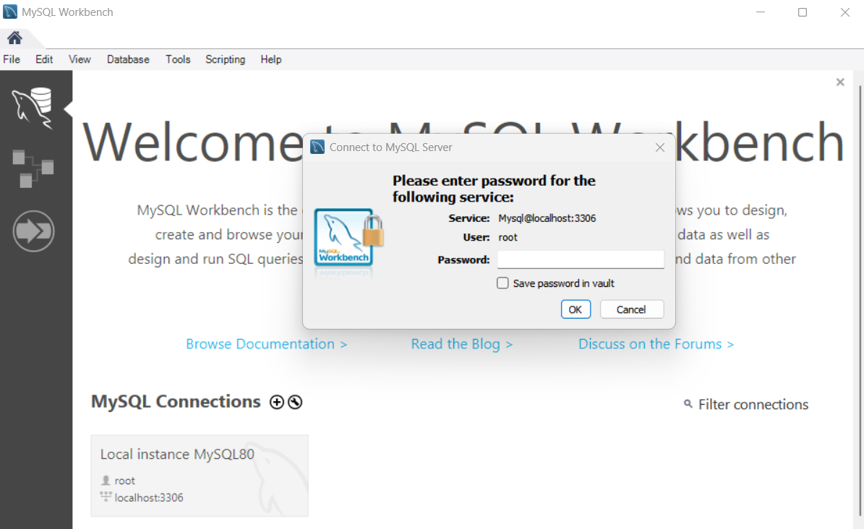
MySQL WorkBench (Mac/Windows)
After installation:
Test MySQL WorkBench
1
Click here
2
Enter password

Slide 32
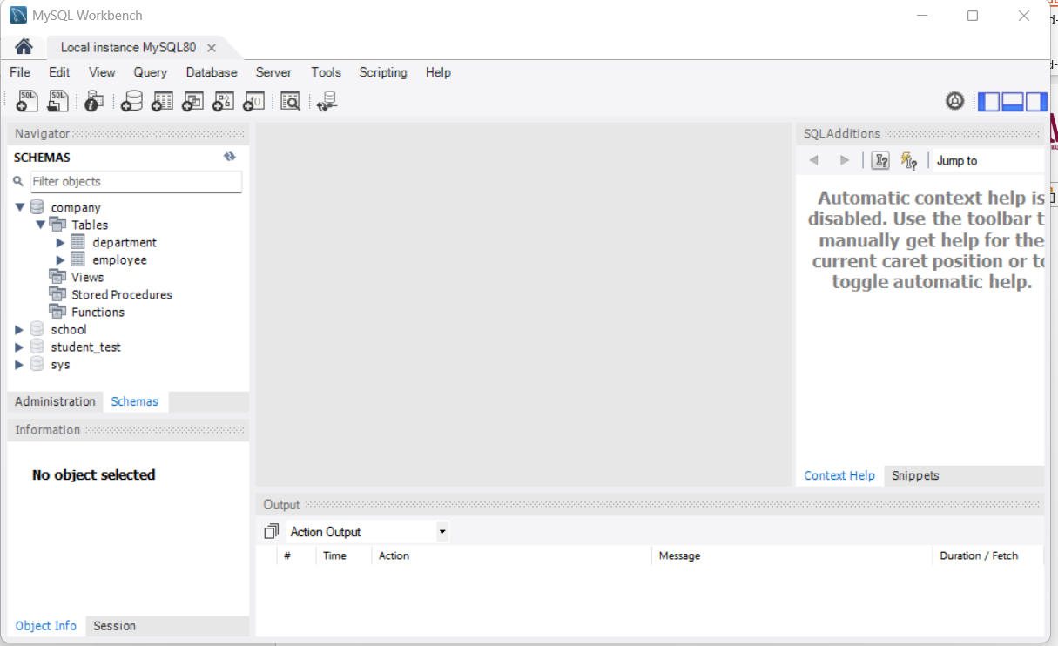
MySQL WorkBench (Mac/Windows)
This will be your view
This is the student_test you have created during testing using MySQL shell

Slide 33
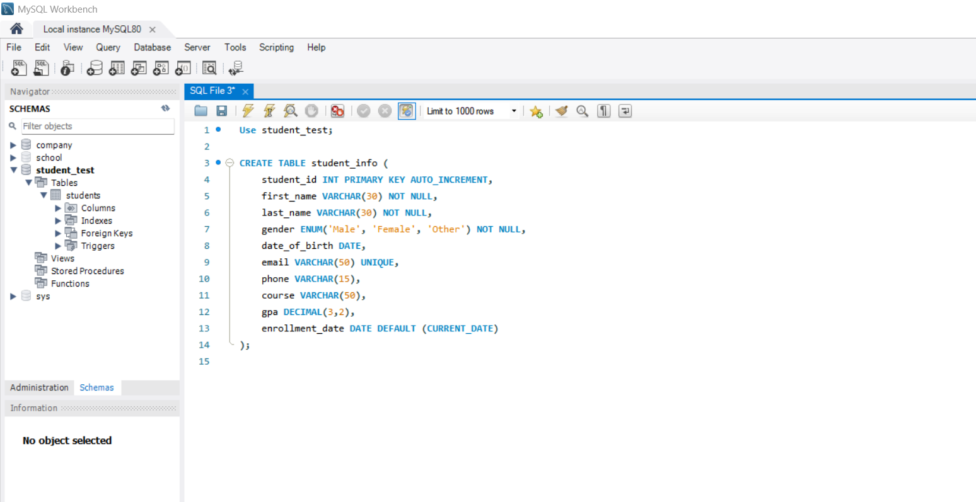
MySQL WorkBench (Mac/Windows)
Once connected, create your practice table:
Execute All Statements
Execute Current Statement
CREATE TABLE student_info as shown above

Slide 34
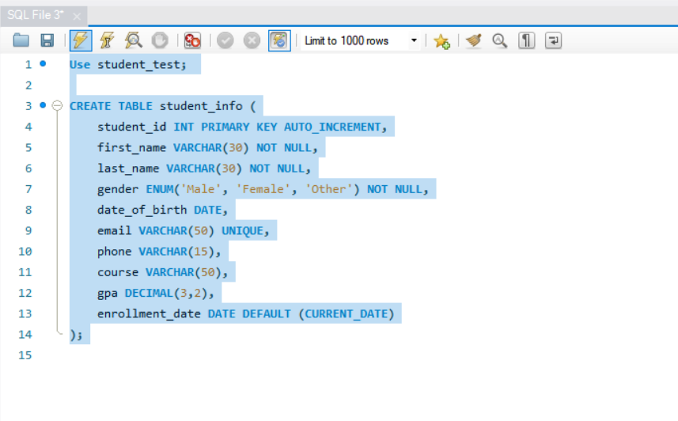
MySQL WorkBench (Mac/Windows)
Execute All Statements
Make sure action output green in color

Slide 35


Right Click and Refresh All to view the updated Tables

Slide 36
Other resources
You may also refer to following link for reference on installing MySql:
https://www.youtube.com/watch?v=05-C-vHN8p4 (Windows)
https://www.youtube.com/watch?v=wpGnJHb2R58&t=336s (Mac)
https://zarkomaslaric.notion.site/Zarko-s-Video-Tutorial-MySQL-Installation-on-Mac-14cfe1ebfde2804c933fecff0e02ca51 (Mac)
(For the provided link for Mac IGNORE the installation of Dbeaver. For this course, you are only required to install MySQL Workbench and MySQL Shell).

Slide 37
THANK YOU

Slide 38


